Slide 1
Blood Basics
PN 306620287

Slide 2
Learning Objectives
      To better understand the basics of blood
      To identify the components of blood
      To learn blood vocabulary
      To understand blood types
Notes:
Today we’re going to start building the foundation for you to have a good understanding of the basics of blood and how important blood donation is to your community.
What is it?
What is it used for?
How different components are used for various needs and common terms that you will encounter in understanding blood.
We’ll talk about the different blood components and then get into the different blood types and how all these pieces fit together in the blood donation process.

Slide 3

Basics of Blood
Blood Factoids:
    In India someone will need a blood transfusion every two seconds¹
    One pint of blood can save up to three lives¹
    If only two more percent of all Indians would give blood, blood shortages would disappear for the foreseeable future¹
    Primary reasons people give for not donating blood:³
        Afraid of needles
        Too busy
        No one ever asked me to donate
    There is no substitute for human blood⁴
¹ Delta Blood Bank, “Blood Facts,” www.deltabloodbank.org/donate/d/blood_facts.html, accessed on September 24, 2013.
² Riley W, et al., “The United States’ Potential Blood Donor Pool: Estimating the Prevalence of Donor-Exclusion Factors on the Pool of Potential Donors,” Transfusion 2007; 47(7): 1180-1188.
³ University of Maryland Medical Center, “Reasons People Don’t Give Blood,” http://umm.edu/about/blood-drives/reasons-people-dont-give, accessed on August 1, 2013.
⁴ BloodBook, “Blood Facts in General,” www.bloodbook.com/facts.html, accessed on August 1, 2013.
Notes:
Here are some interesting facts to demonstrate the ongoing need for blood and how critical volunteer blood donors are in assuring the nation’s blood supply can keep up with demand.
I think you’ll be surprised to see how few people are eligible to donate blood and, even more surprising, how few actually do. We’ll get into the eligibility requirements in a little bit.
This also articulates the fact that just increasing blood donors by 1% nationwide would impact the blood needs and supply challenges that we face on a regular basis.
We’ll also talk further about the fact that most people don’t donate “Because no one ever asked them.”

Slide 4

Basics of Blood
What is Blood?
  Blood is a tissue that provides four critical life-supporting functions:
      Delivers oxygen, hormones and nutrients to the body’s cells
      Prevents blood loss by healing wounds
      Serves as the primary carrier for immunity
      Helps control body temperature
Notes:
This is just a simple definition. Blood is often referred to as “life.” Without a healthy blood system you may become ill with potentially life-threatening illnesses.

Slide 5
Blood Transfusions
Blood transfusions are used to treat:
  Accident victims
  Organ and marrow transplant recipients
  Cancer and heart surgery patients
  People with blood-related diseases
      Sickle Cell Anemia
      Leukemia
      Hemophilia
Notes:
Blood is collected in blood centers like yours for the primary use of transfusions. As we’ll learn today, there are many different scenarios where transfusions are necessary and there are different blood components required to meet those specific transfusion needs.

Slide 6
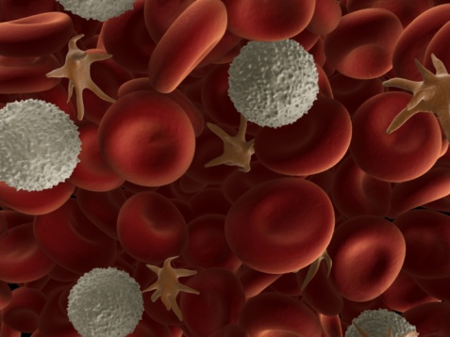
Blood Components
Whole Blood Composition
  Cellular components:
    Red blood cells
    White blood cells
    Platelets
  Liquid component:
    Plasma
Notes:
Earlier we talked about blood being composed of different components. We’ll now go into detail about the four different components, what purpose they serve, reasons they are used in specific transfusions and the life span of each component.

Slide 7
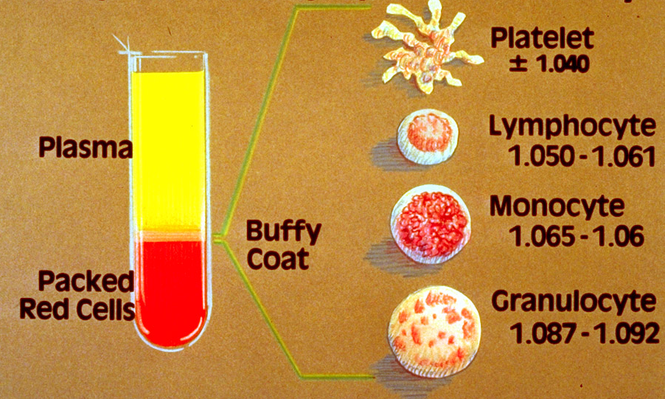
Blood Components
Buffy Coat contains platelets and white blood cells
Notes:
When blood is spun in a centrifuge, separation occurs. This is how blood is separated when extracting certain needed components. This can be done when separating whole blood or when it is done through automated collections. Using centrifugal force, the blood separates into its components by the volume and specific gravity.
Red blood cells are the heaviest with the highest specific gravity, plasma is the lightest. The buffy coat contains the platelets and white blood cells.

Slide 8
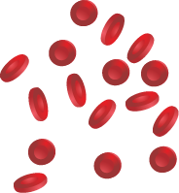
Components
Red Blood Cells (RBCs)
  Purpose/facts:
    Contains a complex iron-containing protein called hemoglobin that gives blood its red color
    Carries oxygen to all parts of the body
    The body contains more RBCs than any other cell type
  Reasons for transfusion:
    Severe anemia
    Blood loss from injury
    Major surgery or disease
  Circulation life span—about 120 days
  RBC unit shelf life—35 to 42 days
Notes:
Red blood cells make up between 36 percent to 50 percent of your total blood volume—the most of any component.
An RBC has a strange shape—a biconcave disc that is round and flat, sort of like a shallow bowl.
RBCs can also change shape without breaking, as they squeeze single file through the capillaries. (Capillaries are minute blood vessels through which oxygen, nutrients and waste products are exchanged throughout the body.)

Slide 9
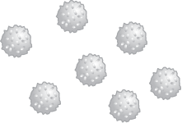
Blood Components
White Blood Cells
  Purpose/facts:
    Key to the body’s immune system
    Less than 1% of total blood volume; rarely collected for transfusions
    Only ordered when urgently needed
    The body's primary defense against infection
  Reasons for transfusions:
    Overwhelming infections
    In addition to/instead of bone marrow transplants
    Circulation life span—few days to a few weeks
  White blood cell unit shelf life—4 to 6 hours
Notes:
White blood cells are all about protecting the immune system. White blood cells are continually on the lookout for signs of disease. When a germ does appear, the white blood cells have a variety of ways by which they can attack. Some will produce protective antibodies that will overpower the germ. Others will surround and devour the bacteria.
Unlike red blood cells and platelets that are a specific type of cell, there are various types—or categories, or subcategories—of white blood cells which include:
Lymphocytes – generally collected for research purposes.
Granulocytes – used to treat patients who have an overwhelming infection. Ordered only when urgently needed.
Stem Cells – used as alternative for bone marrow transplant.

Slide 10

Blood Components
Platelets
  Purpose/facts:
    Essential for blood clotting
    Forms platelet clot at an injury site
  Reasons for transfusions:
    Acute blood loss
    Reduced platelet production due to
    chemotherapy
    Improperly functioning platelets
    Open-heart surgery
    Organ transplants
  Circulation life span—7 to 10 days
  Platelet unit shelf life—5 to 7 days
Notes:
Platelets are primarily responsible for preventing blood loss from the body. They are produced in the bone marrow, the same as the red blood cells and most of the white blood cells. Platelets are actually not true cells but merely circulating fragments of cells.
If the number of platelets is too low, excessive bleeding can occur. However, if the number of platelets is too high, blood clots can form, which may obstruct blood vessels and result in an event such as a stroke.

Slide 11
Blood Components
Transfusion Platelet Doses:
These doses are on average and can vary for each patient.
  Trauma patients: 2 to 4 units in first 24 hours or until stabilized
  Organ transplant:
    Heart: 1 to 4 units
    Liver: 2 to 6 units
    Lung: 1 to 4 units
    Heart/Lung: 2 to 6 units
  Bone marrow: 2 to 4 units/day
  Premature baby (less than 30 weeks gestation): 1 unit/day
  Chemotherapy: 1 to 2 units/day
  Cardiac bypass: 1 to 2 units
Notes:
Here are a few examples of the amount of platelets needed for various procedures. You can see the wide-range of patients that require platelet transfusions.

Slide 12

Blood Components
Plasma
  Purpose/facts:
    90% water
    Carries blood cells, proteins, hormones and other substances
    Accounts for about 55% of total blood volume
    Fresh frozen plasma is used in transfusions
  Reasons for transfusions:
    Coagulation or bleeding disorders
    Acute blood loss
    Severe burns
Plasma unit shelf life—once frozen, can be stored for
1 to 7 years
Notes:
Blood plasma is the yellow liquid component of blood in which the blood cells in whole blood are normally suspended. It makes up about 55 percent of the total blood volume. As plasma circulates through the body, it acts like a deliveryman making deliveries. The plasma drops off various substances to the cells of the body, and collects waste products for processing. Blood plasma flows constantly, and the components of plasma are constantly being renewed. In addition to providing nutrition and waste cleanup, blood plasma also carries immune system cells which attack infections in the body, and it is used to deliver hormones and clotting factors to areas where they are needed.
Plasma needs to be frozen within hours of donation. Fresh frozen plasma can be stored frozen for up to 1 year at –18C or 7 years at –65C. Once it's thawed for use, it needs to be transfused or kept refrigerated for up to 24 hours. Plasma can also be packaged in dried form for reconstitution, a technique that was developed for military applications.

Slide 13
Blood Vocabulary
Antigen:
  Substance, usually a protein, that stimulates production of an antibody and is found on red blood cells, white blood cells and platelets
Antibody:
  Protein that is found in plasma is produced in response to a foreign substance such as transfused cells or invading organisms
Hemoglobin:
  Oxygen-carrying pigment of red blood cells that gives them their red color and serves to carry oxygen to the tissues
Hematocrit:
  Blood test that measures the percentage of whole blood volume that is
  made up of red blood cells
Notes:
As with any occupation or profession, there is a long list of words and terms that you will encounter on a regular basis. These are just a few in order to begin building the knowledge base of blood donation:
Antigen: an antigen is a substance/molecule that, when introduced into the body, triggers the production of an antibody by the immune system, which will then kill or neutralize the antigen that is recognized as a foreign and potentially harmful invader. Antigens often enter the body via an infection.
Antibodies: proteins found in the blood that detect and destroy invaders, like bacteria and viruses. The production of antibodies is a major function of the immune system.
Hemoglobin: found in the RBCs which transports oxygen from the lungs to the rest of the body where it releases the oxygen for cell use and collects carbon dioxide to bring it back to the lungs.
Hematocrit : measurement of percentage of whole blood volume made up of red blood cells. A typical value in a healthy adult is about 45 percent. A minimum hematocrit for a healthy donor is 38 percent.

Slide 14
Blood Types
What makes blood a certain “type:”
  There are 30 major blood group systems
  (including the ABO and Rh systems)
  Each is genetically inherited and expresses antigens on red blood cells that are unique
  There are more than 400 blood group antigens
  Your blood type is determined by your parents
    Mother is A and father is B = child will be AB
    Mother is B and father is O = child possible B or O
    Mother is O and father is O = child possible O
Notes:
While there are 30 major blood group systems the two most important groups in transfusion medicine are the ABO and Rh systems. The lesser known systems are not critical for what you will be dealing with on a regular basis unless the intended recipient has made an antibody to one of these antigens.
Remember when discussing antigens previously ……. they are the substances that are capable of stimulating production of an antibody.
Each of us has two ABO blood type alleles (or genes), because we each inherit one blood type allele from our biological mother and one from our biological father.

Slide 15
Blood Types
The “ABO” blood group:
  The most important blood group system in blood banking
  ABO antibodies are found in the plasma
  Antibodies to the ABO antigens appear naturally in the plasma after birth
  ABO incompatibility between recipient and donor is a serious complication

Slide 16
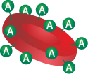
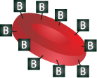
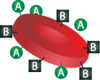

ABO Type
Type A: Inherit an “A” antigen on their RBCs
Type B: Inherit a “B” antigen on their RBCs
Type AB: Inherit both an “A” and a “B” antigen
*The universal RBC recipient
Type O: Does not display any ABO antigens
*The universal RBC donor

Slide 17
Blood Types
The “Rh” system:
Clinically, the most important blood group system after ABO
Also inherited from our parents, but inherited independently
of the ABO blood type alleles
The presence or absence of the Rh (“D”) antigen on a red blood cell determines whether a person is Rh+ or Rh-
The “Rh” antibody does not naturally occur and only develops
after exposure to RBCs that contain the D antigen

Slide 18
Donors and Recipients by Blood Type
Notes:
As you can see by this chart, a group O donor is considered a universal RBC donor and an AB positive can accept (or be given) RBCs of any blood type – the universal recipient.
In addition , since AB plasma can be safely given to any recipient, the AB donor is the universal plasma donor.

Slide 19
Learning Objectives
    To better understand the basics of blood
    To identify the components of blood
    To learn blood vocabulary
    To understand blood types
Notes:
We’ve gone over a lot in this section, but I hope it’s given you a basic understanding of blood, the components and why transfusions are critical to so many people in your community.
We talked about the four blood components, which are (ASK THEM TO NAME THE COMPONENTS).
I hope the vocabulary was useful and you now understand how blood types are determined along with a working knowledge of the ABO Blood Group and the “Rh” System.

Slide 20
References
    AABB, “Donor Services Training: Everything you Need to Know to Process Donors,” 2010, AABB, Bethesda, Maryland.
AABB, Technical Manual, 2011, 17th edition, AABB, Bethesda, Maryland.
Dailey JF, Dailey’s Notes on Blood, 2002, fourth edition, Medical Consulting Group, Arlington, Massachusetts.
McLeod BC, et al. (eds.), Apheresis Principles and Practice, third edition, AABB Press, Bethesda, Maryland.

